Slide 1
Project figures and tables
In order of assumed appearance/reference in the manuscript

Slide 2
Objective 1
describe patterns in assemblage composition

Slide 3
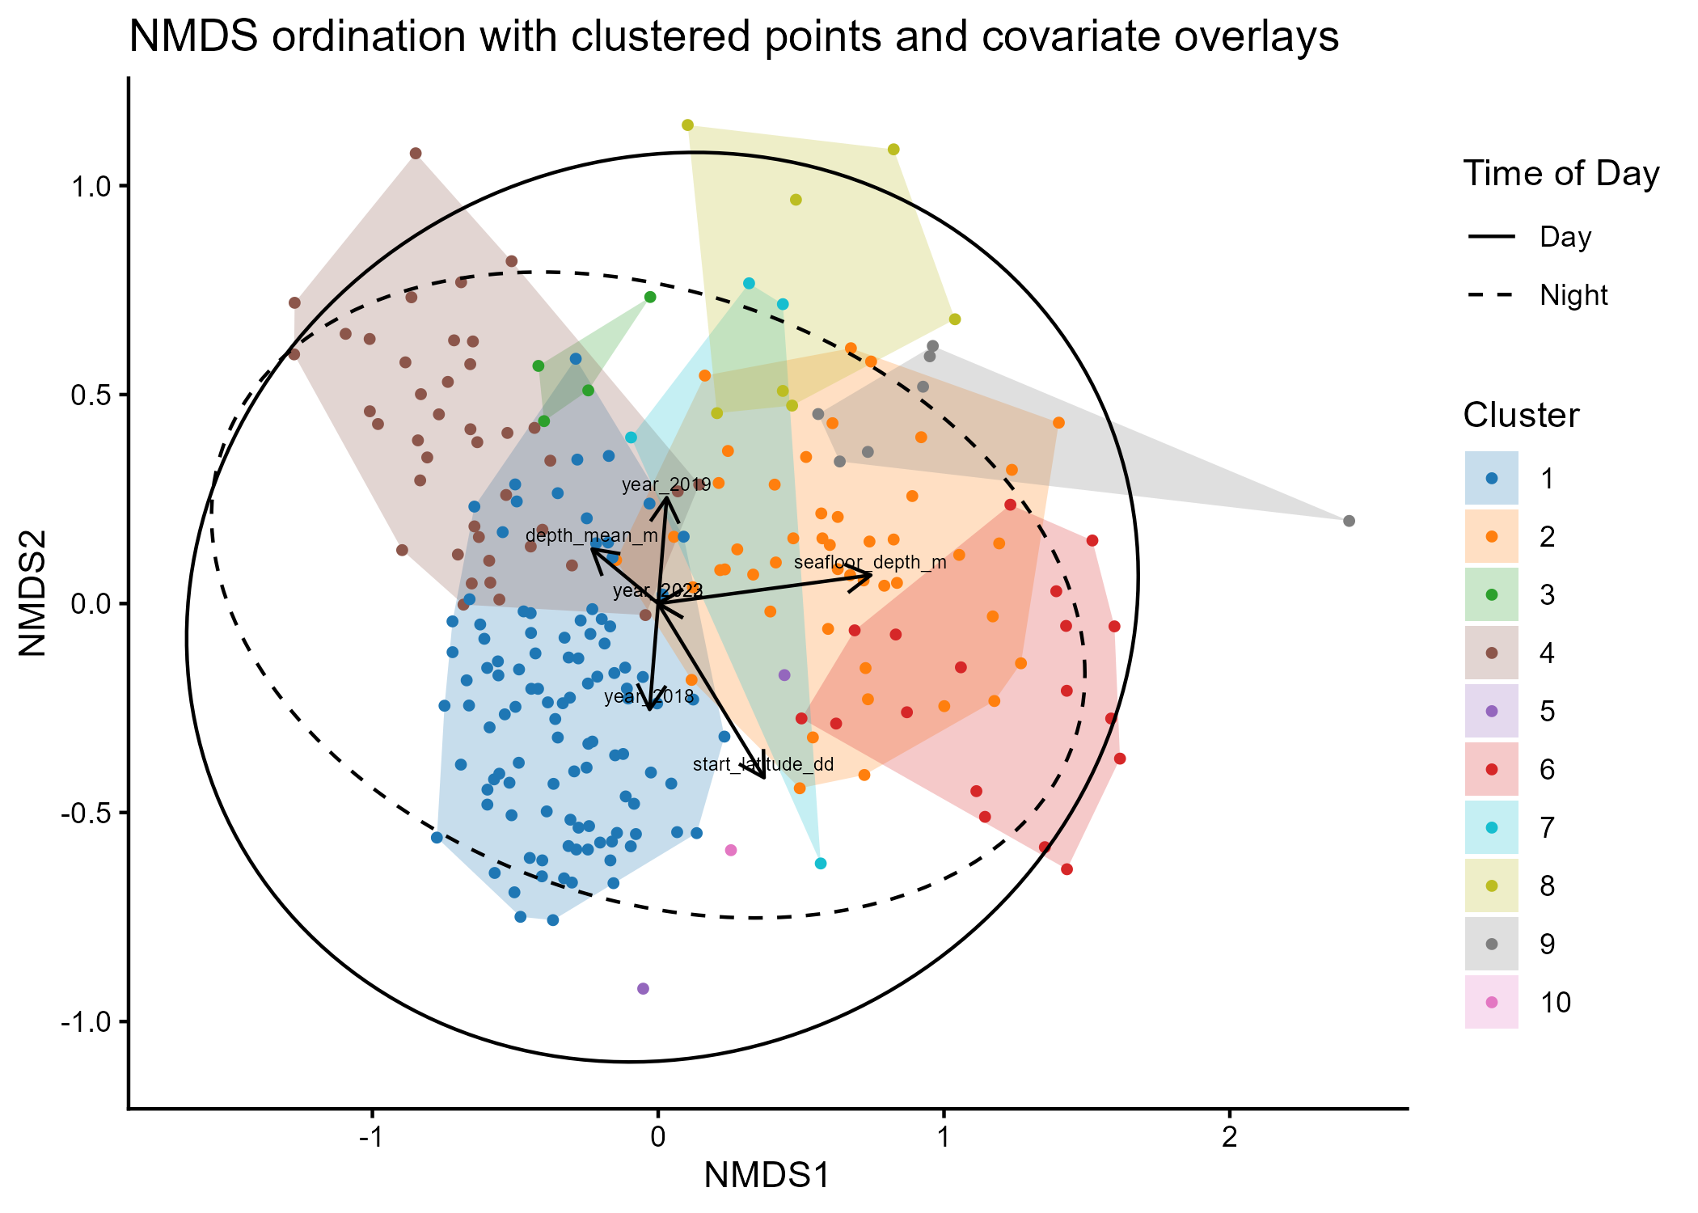
Figure 1: NMDS ordination plot of net tows with overlaid vectors and ellipses. Points and polygons are colored by cluster to visualize the unconstrained variation in assemblage composition. Overlaid vectors and ellipses visualize correlation between clusters and spatiotemporal covariates in ordination space.

Slide 4
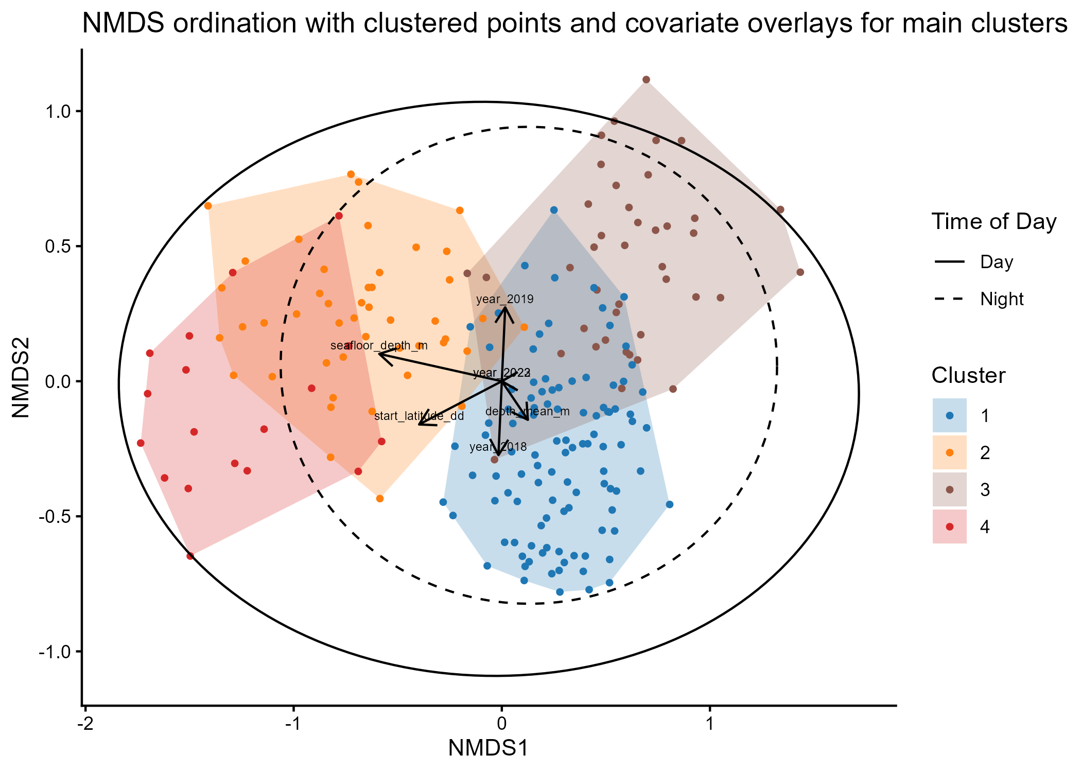
Figure 2: NMDS ordination plot of net tows from the four largest clusters (1, 2, 4, and 6, previously) with overlaid vectors and ellipses. Points and polygons are colored by cluster to visualize the unconstrained variation in assemblage composition. Overlaid vectors and ellipses visualize correlation between clusters and spatiotemporal covariates in ordination space.

Slide 5
Objective 2
Quantify the effects of spatiotemporal and environmental variables on assemblage composition

Slide 6
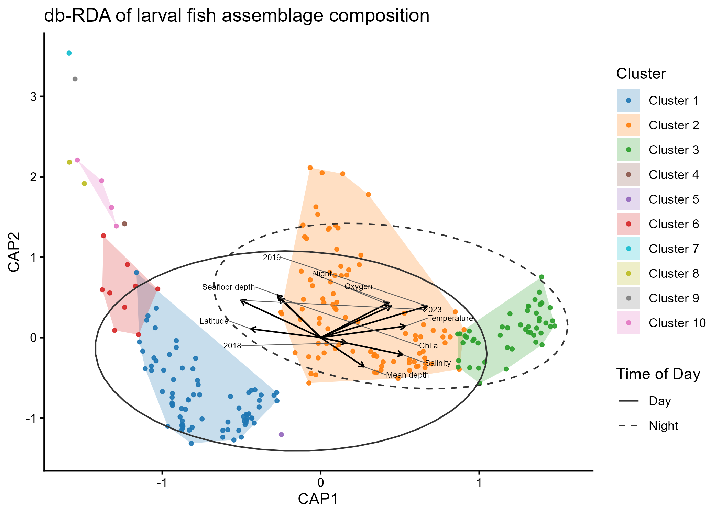
Figure 3: …

Slide 7
dbRDA model | R² | Adj. R² | Pseudo-F | p
Spatiotemporal | 0.09 | 0.062 | 3.21 | 0.001
Spatiotemporal + environmental | 0.12 | 0.08 | 2.74 | 0.001
Model term | Df | Pseudo-F | p
Year | 3 | 1.86 | 0.001
Day/night | 1 | 1.28 | 0.038
Latitude | 1 | 2.67 | 0.001
Mean tow depth | 1 | 2.94 | 0.001
Seafloor depth | 1 | 2.13 | 0.001
Temperature | 1 | 1.70 | 0.004
Salinity | 1 | 1.39 | 0.021
Dissolved oxygen | 1 | 2.54 | 0.001
Chlorophyll | 1 | 2.33 | 0.001
Model component | Variance explained
Spatiotemporal | 0.0367
Environmental | 0.0137
Shared | 0.0254

Slide 8
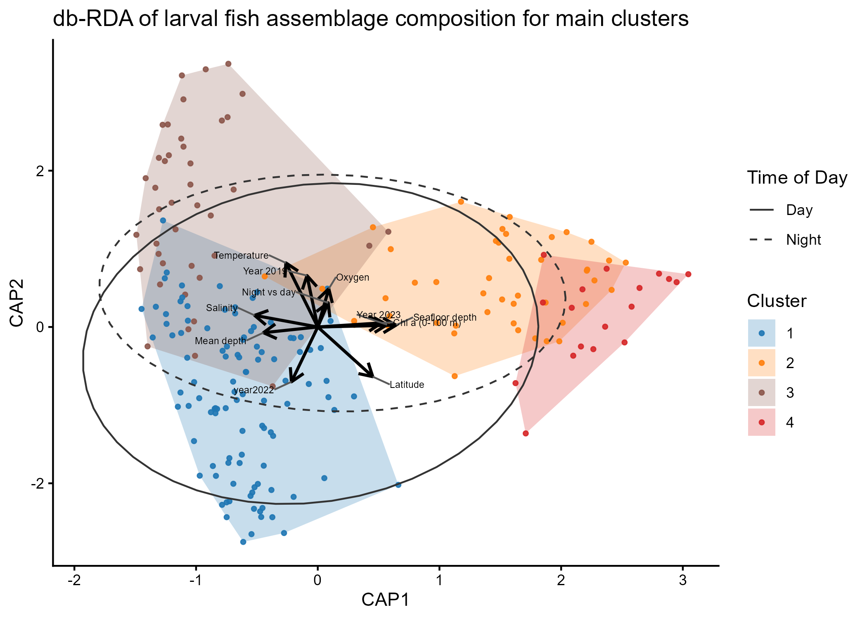
(alternative?) Figure 3: …

Slide 9
dbRDA model | R² | Adj. R² | Pseudo-F | p
Spatiotemporal | 0.10 | 0.069 | 3.20 | 0.001
Spatiotemporal + environmental | 0.13 | 0.08 | 2.68 | 0.001
Model term | Df | Pseudo-F | p
Year | 3 | 1.86 | 0.001
Day/night | 1 | 1.28 | 0.041
Latitude | 1 | 2.67 | 0.001
Mean tow depth | 1 | 2.94 | 0.001
Seafloor depth | 1 | 2.13 | 0.001
Temperature | 1 | 1.70 | 0.002
Salinity | 1 | 1.39 | 0.012
Dissolved oxygen | 1 | 2.54 | 0.001
Chlorophyll | 1 | 2.33 | 0.001
Model component | Variance explained
Spatiotemporal | 0.0394
Environmental | 0.0146
Shared | 0.0234

Slide 10
Objective 3
Assess how vertical position of larvae differs between day and night

Slide 11
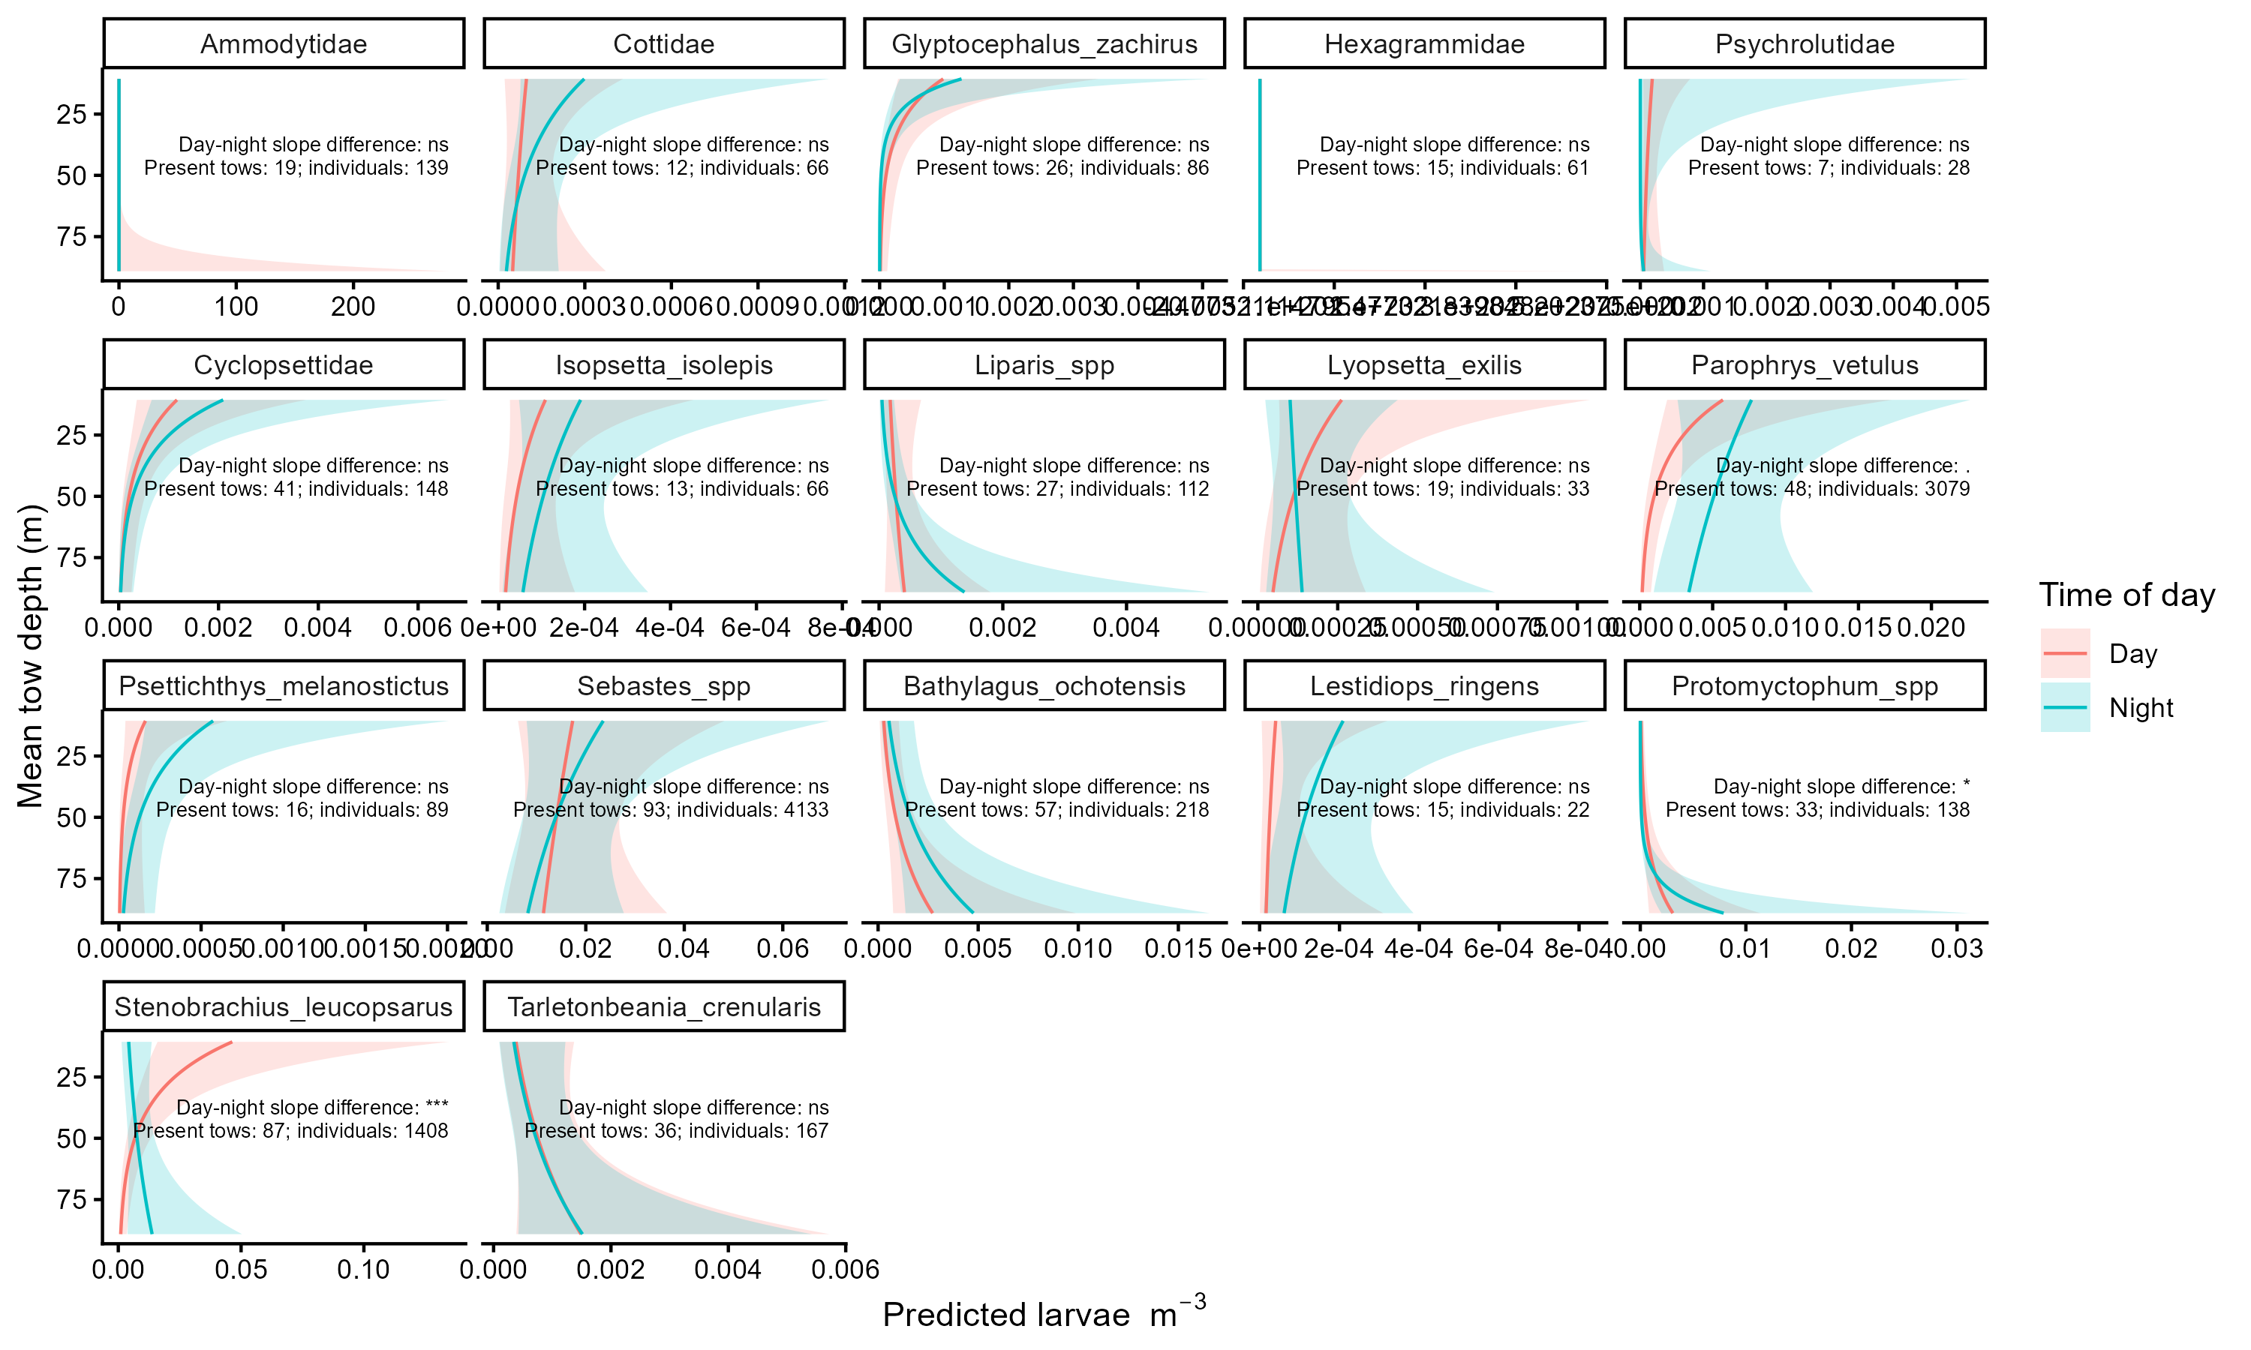
Figure 8: …

Slide 12
Table 1: Single-taxa models w/ p-values for parameters…
Sebastes spp.
Parameter | p-value
Intercept | < 2e-16 ***
Time of day (night) | 0.7839
Mean depth (m) | 0.3189
Seafloor depth (m) | 0.1719
Mean temperature (C) | 6.50e-11 ***
Mean salinity | 0.00499 **
DO | 4.47e-06 ***
Mean productivity (chlorophyll) | 0.0640
Time of day (night):mean depth | 0.6541
Stenobrachius leucopsarus
Parameter | p-value
Intercept | < 2e-16 ***
Time of day (night) | 0.6805
Mean depth (m) | 0.0252 *
Seafloor depth (m) | 3.96e-06 ***
Mean temperature (C) | 4.32e-07 ***
Mean salinity | 0.5787
DO | 0.00236 **
Mean productivity (chlorophyll) | 0.00855 **
Time of day (night):mean depth | 0.00331 **
Parophrys vetulus
Parameter | p-value
Intercept | < 2e-16 ***
Time of day (night) | 4.52e-10 ***
Mean depth (m) | 7.74e-08 ***
Seafloor depth (m) | 8.59e-12 ***
Mean temperature (C) | 0.0343 *
Mean salinity | 0.5417
DO | 5.58e-05 ***
Mean productivity (chlorophyll) | 0.2816
Time of day (night):mean depth | 0.000233 ***
Ammodytidae
Parameter | p-value
Intercept | NaN
Time of day (night) | NaN
Mean depth (m) | NaN
Seafloor depth (m) | NaN
Mean temperature (C) | NaN
Mean salinity | NaN
DO | NaN
Mean productivity (chlorophyll) | NaN
Time of day (night):mean depth | NaN

Slide 13
Figures and Tables to appear in supplemental materials

Slide 14
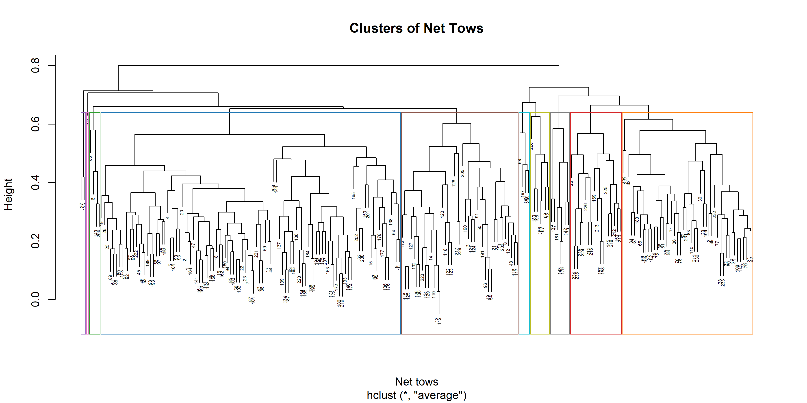
Supplemental Figure 1: Dendrogram of net tows clustered by agglomerative hierarchical clustering. Number of clusters determined as the fewest necessary to yield expected groups (k = 10).

Slide 15
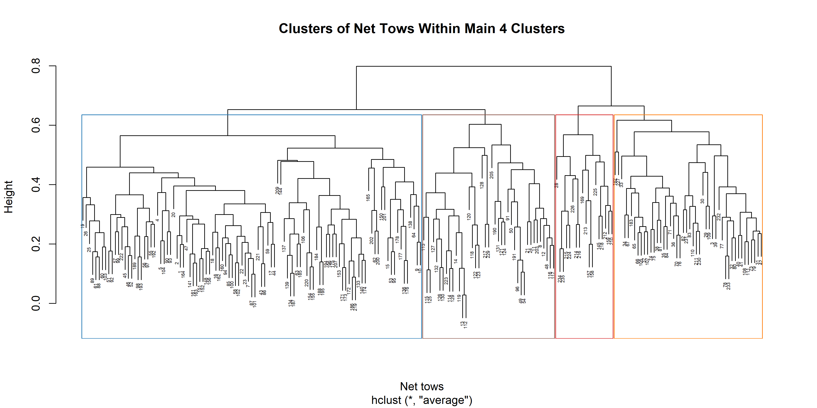
(alternative?) Supplemental Figure 1: Dendrogram of net tows belonging to the four largest clusters resulting from agglomerative hierarchical clustering (AHC) of the entire data set. AHC was ran on the filtered net tows to yield the resultant dendrogram with four cluster rectangles (k = 4).

Slide 16
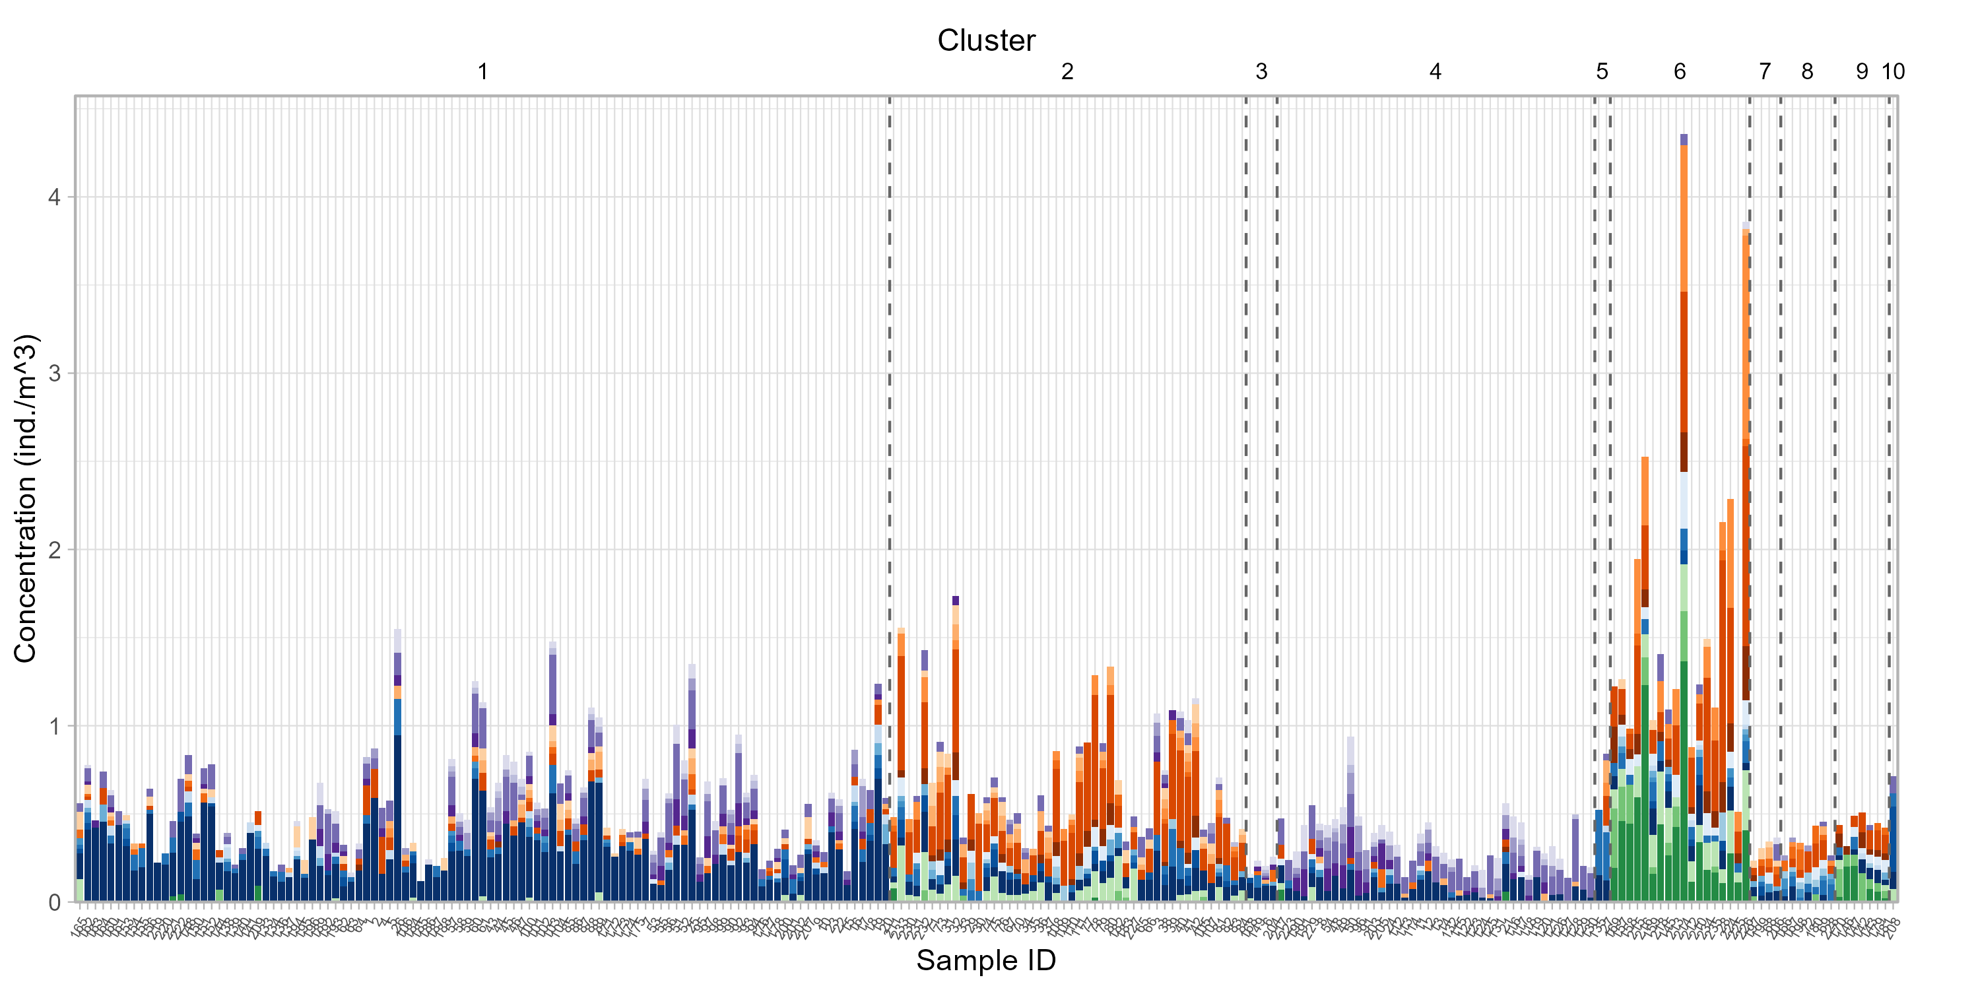
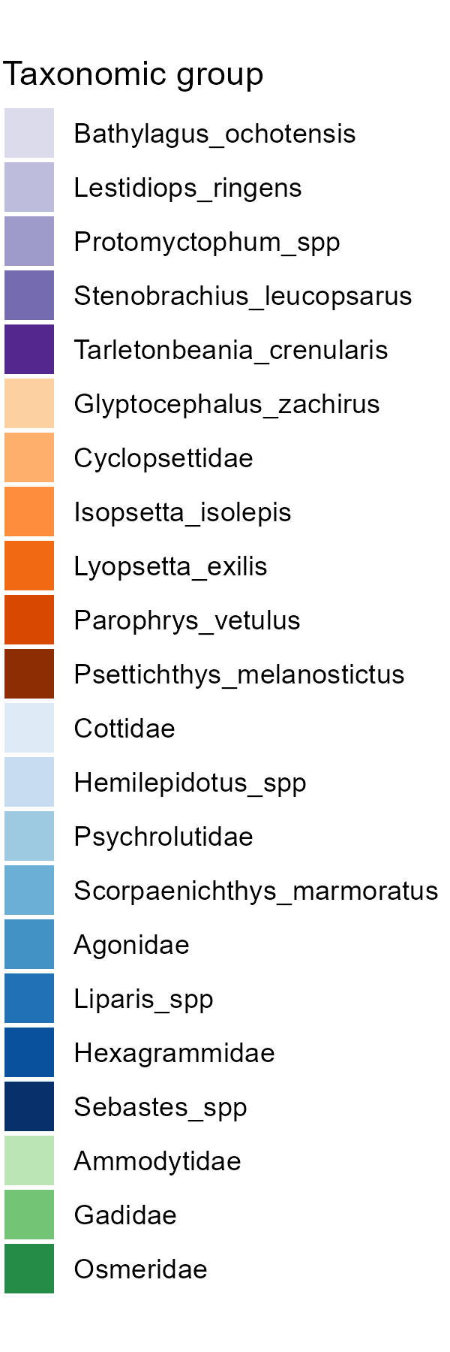
Supplemental Figure 2: Bar plot of taxa concentrations (individuals per m3) in each net tow. Tows are organized by cluster to show the approximate composition of each cluster.

Slide 17
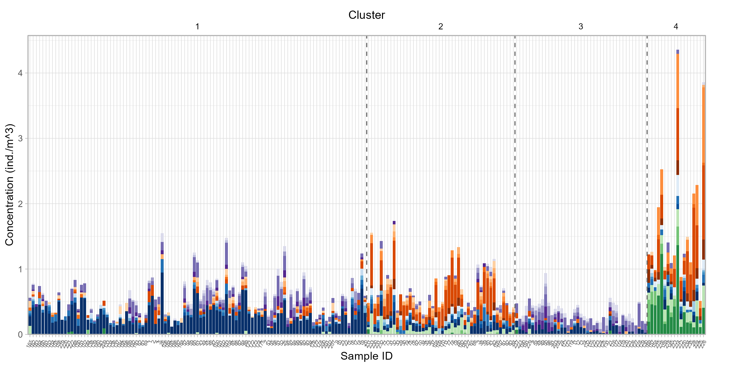
(alternative?) Supplemental Figure 2: Bar plot of taxa concentrations (individuals per m3) in each net tow belonging to the four main clusters. Tows are organized by cluster to show the approximate composition of each cluster of interest.

Slide 18
Supplemental Table 1: Results of indicator species analysis (ISA) on net tows clustered by AHC. Max number of clusters that can be indicated together set equal to two. Used to verify the dominant taxa for each cluster and the use of clusters as representatives of taxa assemblages.
Cluster(s) | Taxa | p-value
10 | Hexagrammidae | 0.005 **
1 + 5 | Sebastes spp. | 0.005 **
2 + 6 | Parophrys vetulus | 0.005 **
3 + 4 | Bathylagus ochotensis | 0.025 *
4 + 10 | Stenobrachius leucopsarus | 0.01 **
5 + 6 | Isopsetta isolepis | 0.02 *
5 + 10 | Liparis spp. | 0.005 **
6 + 9 | Osmeridae Psettichthys melanostictus Gadidae | 0.005 ** 0.005 ** 0.050 *
6 + 10 | Ammodytidae | 0.005 **

Slide 19
(alternative?) Supplemental Table 1: Results of indicator species analysis (ISA) on net tows from four main clusters in the overall AHC. Max number of clusters that can be indicated together set equal to two. Used to verify the dominant taxa for each cluster and the use of clusters as representatives of taxa assemblages.
Cluster(s) | Taxa | p-value
2 | Cyclopsettidae | 0.005 **
3 | Bathylagus ochotensis Protomyctophum spp. | 0.005 ** 0.005 **
4 | Osmeridae Isopsetta isolepis Psettichthys melanostictus Cottidae Gadidae | 0.005 ** 0.005 ** 0.005 ** 0.005 ** 0.005 **
1 + 2 | Sebastes spp. Glyptocephalus zachirus | 0.005 ** 0.005 **
1 + 3 | Stenobrachius leucopsarus Tarletonbenia crenularis | 0.005 ** 0.005 **
1 + 4 | Hemilepidotus spp. | 0.02 *
2 + 4 | Parophrys vetulus Ammodytidae Liparis spp. Hexagrammidae Psychrolutidae Scropaenichthys marmoratus | 0.005 ** 0.005 ** 0.005 ** 0.005 ** 0.010 ** 0.050 **

Slide 20
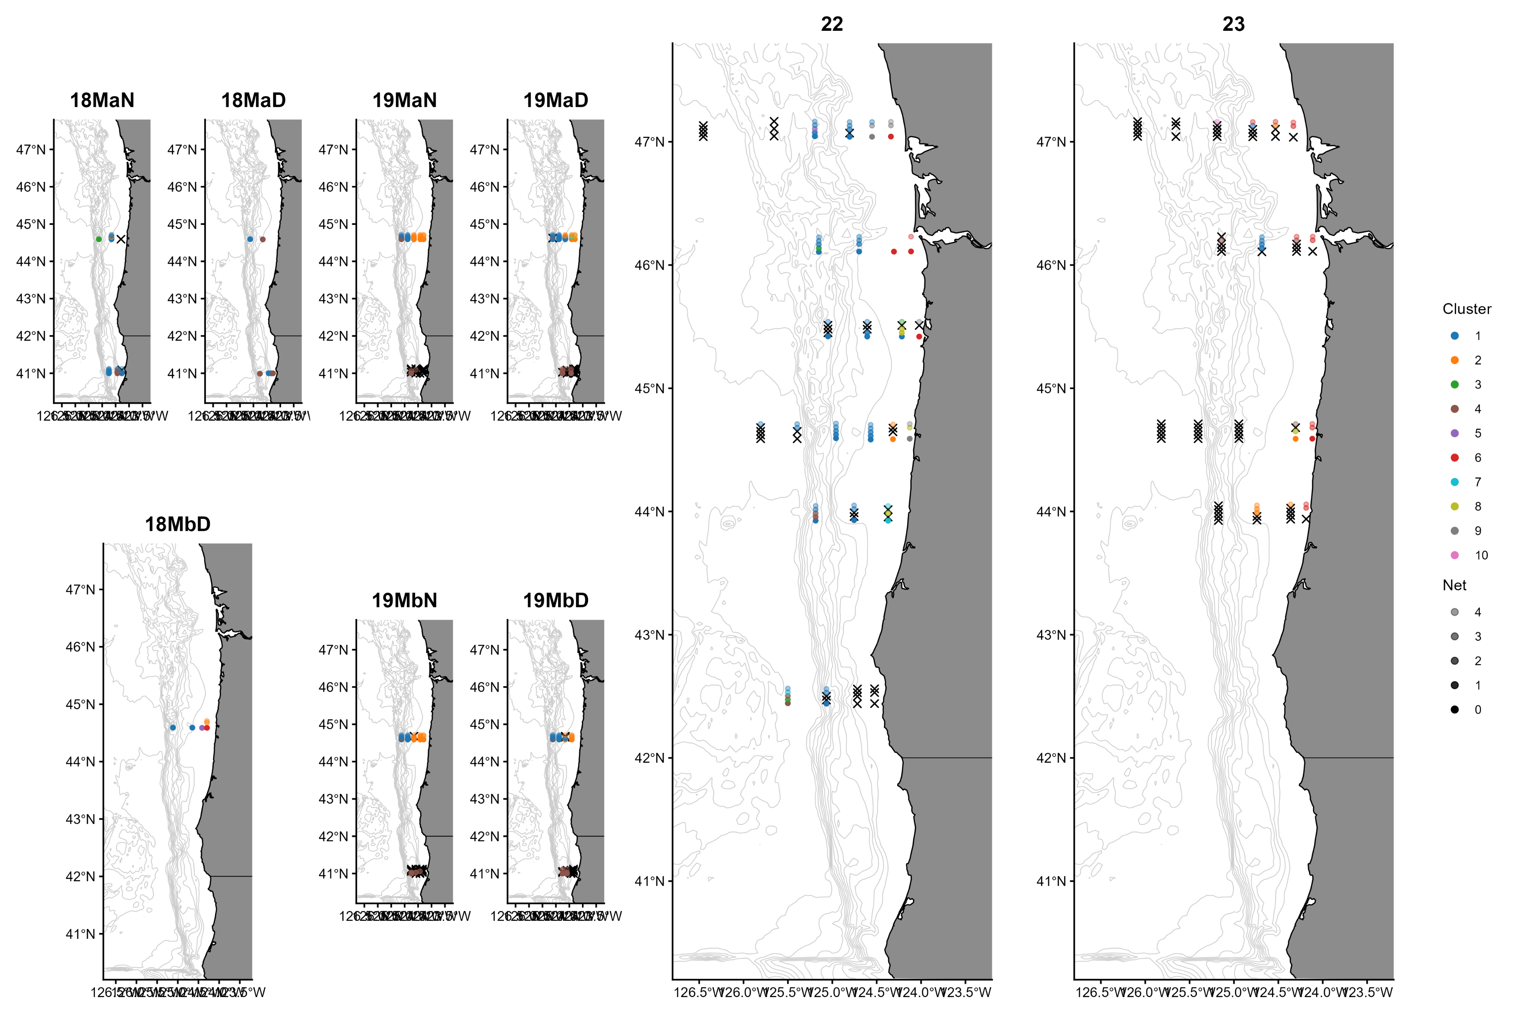
Supplemental Figure 3: Map of sampling events in space based on latitude and longitude of sampling stations. Points at each station are organized by net tow which is indicative of depth (0 = 1-100m, 1 = …). Points are also colored by cluster. Used to assess how clusters organized in space and thus how ichthyoplankton assemblages might be distributing.
Notes:
If these are in supplemental materials, perhaps we can add separate frames maybe by year so they’re easier to look at than in this format?

Slide 21
(alternative?) Supplemental Figure 3: Map of sampling events belonging to the four largest clusters (1, 2, 4, and 6, previously) in space based on latitude and longitude of sampling stations. Points at each station are organized by net tow which is indicative of depth (0 = 1-100m, 1 = …). Points are also colored by cluster. Used to assess how clusters organized in space and thus how ichthyoplankton assemblages might be distributing.
Notes:
If these are in supplemental materials, perhaps we can add separate frames maybe by year so they’re easier to look at than in this format?

Slide 22
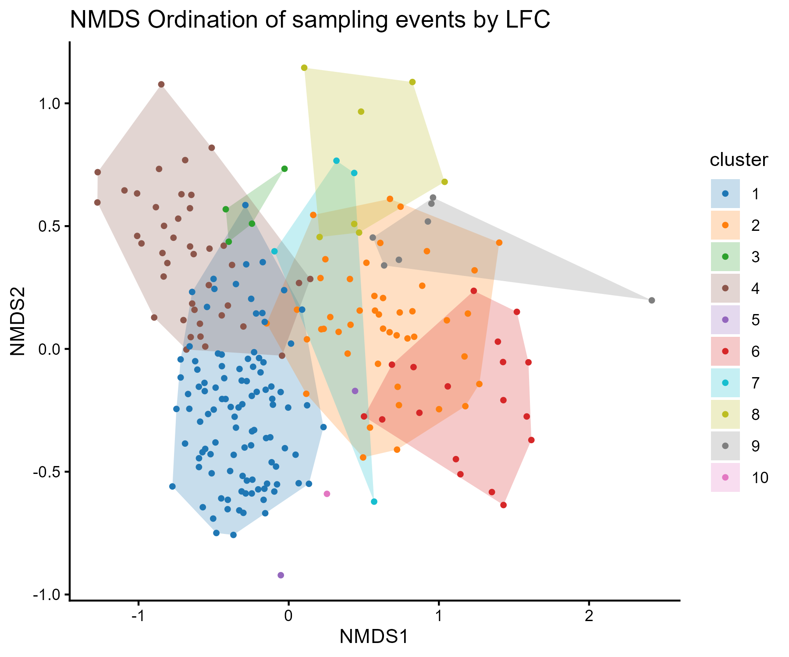
Supplemental Figure 4: NMDS ordination plot of net tows. Points and polygons are colored by cluster to visualize the unconstrained variation in assemblage composition and relationships between and within clusters in ordination space.

Slide 23
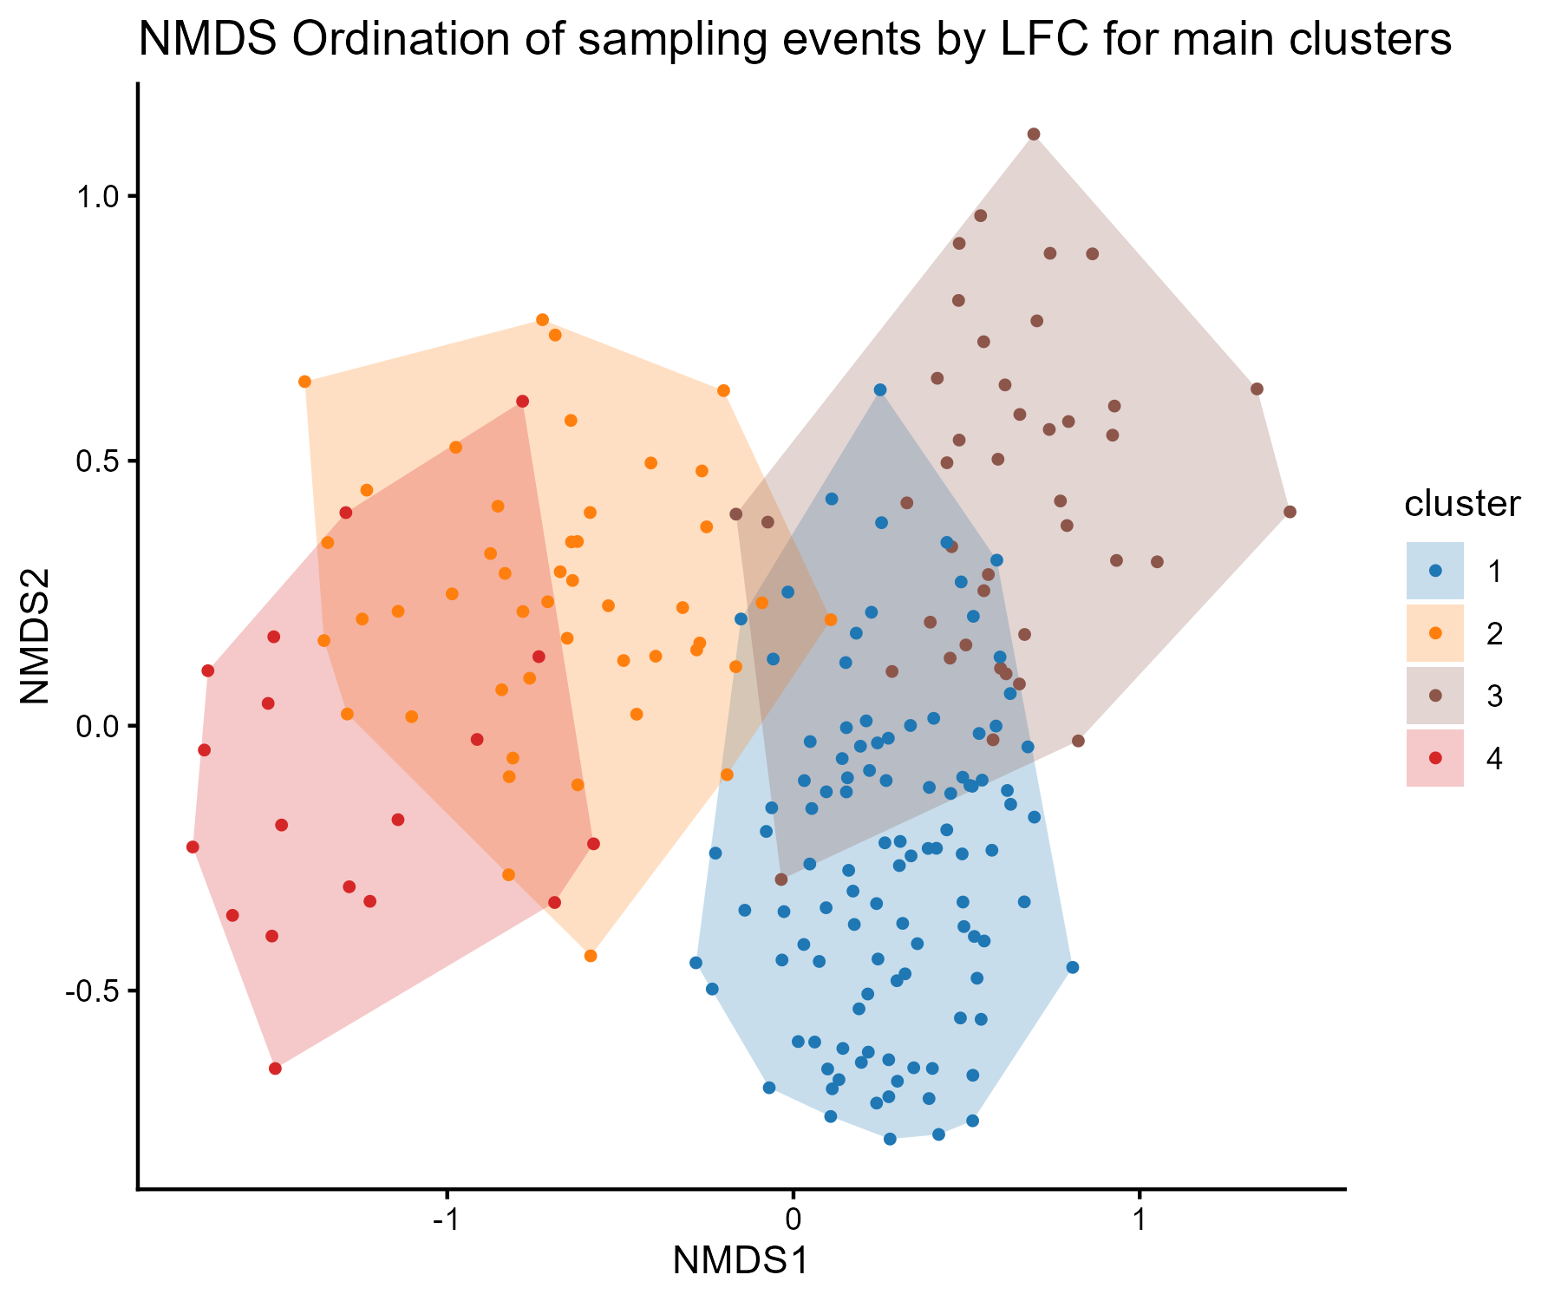
(alternative?) Supplemental Figure 4: NMDS ordination plot of net tows from the four largest clusters (1, 2, 4, and 6, previously). Points and polygons are colored by cluster to visualize the unconstrained variation in assemblage composition and relationships between and within clusters in ordination space.

Slide 24
Supplemental Table 2: Results of NMDS stress null model to assess the fit of the NMDS of net tows based on methodology from Dexter et al. (2018). Values rounded to the nearest ten-thousandth place
Observed stress null pipeline | Observed stress sqrt concentration | Null pipeline mean stress | Null pipeline stress standard deviation | Null pipeline stress lower quantile | Null pipeline stress upper quantile | Z-statistic | Two-tailed p-value | Number of permutations
0.2009 | 0.2012 | 0.2887 | 0.0042 | 0.2803 | 0.2968 | -20.7979 | 4.5222e-96 | 1000

Slide 25
(alternative?) Supplemental Table 2: Results of NMDS stress null model to assess the fit of the NMDS of net tows from the main four clusters based on methodology from Dexter et al. (2018). Values rounded to the nearest ten-thousandth place
Observed stress null pipeline | Observed stress sqrt concentration | Null pipeline mean stress | Null pipeline stress standard deviation | Null pipeline stress lower quantile | Null pipeline stress upper quantile | Z-statistic | Two-tailed p-value | Number of permutations
0.1852 | 0.1852 | 0.2842 | 0.0048 | 0.02747 | 0.2930 | -20.7859 | 5.8121e-96 | 1000

Slide 26
Supplemental Figure 5: Distribution of stress values from the NMDS stress null model of net tows based on methodology from Dexter et al. (2018).

Slide 27
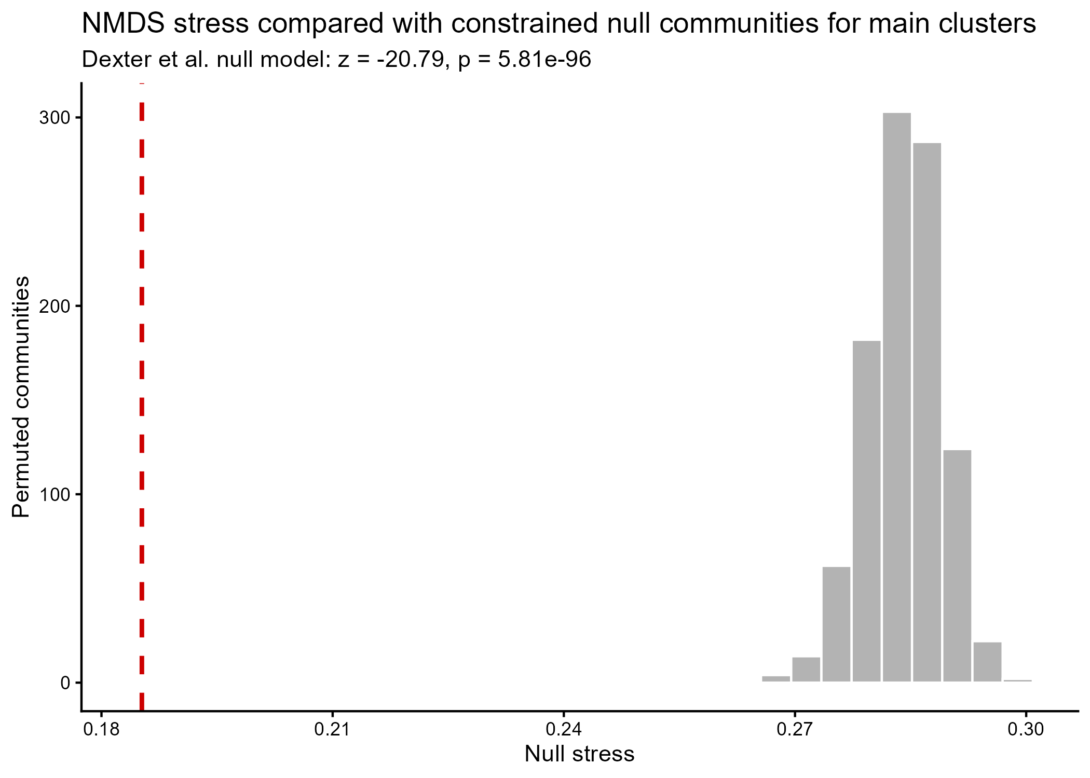
(alternative?) Supplemental Figure 5: Distribution of stress values from the NMDS stress null model of net tows from the four main clusters based on methodology from Dexter et al. (2018).

Slide 28
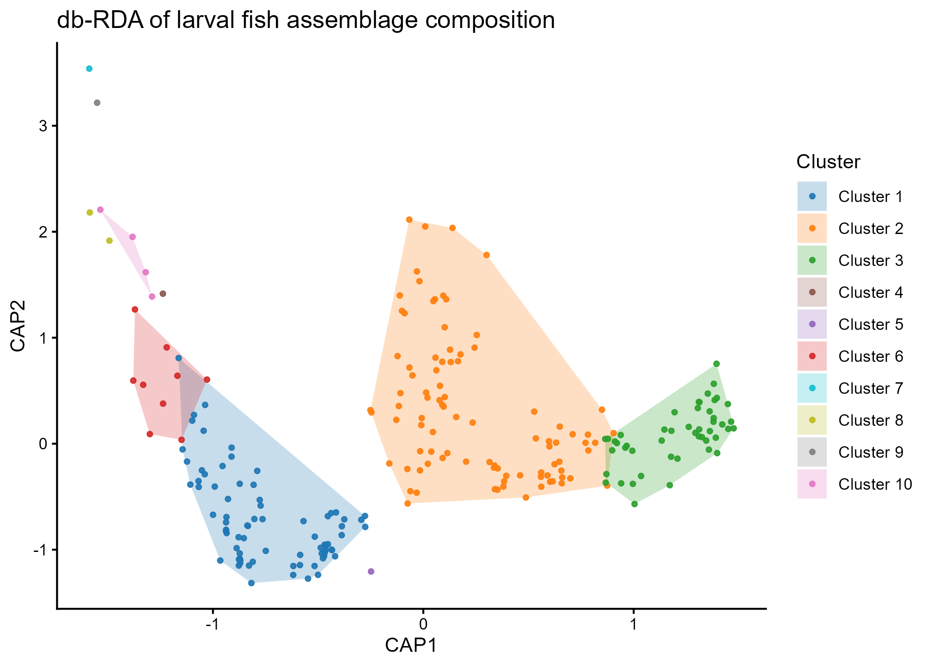
Supplemental Figure 6:…

Slide 29
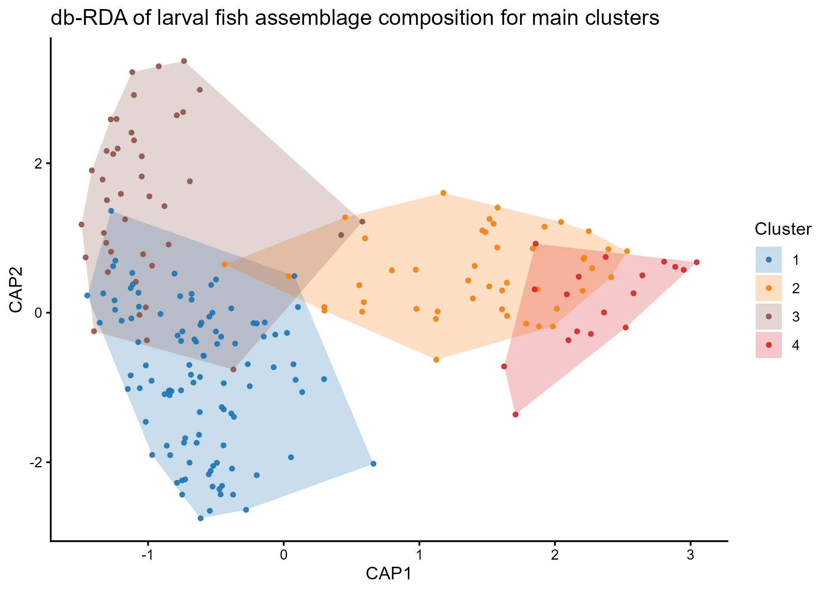
(alternative?) Supplemental Figure 6:…

Slide 30
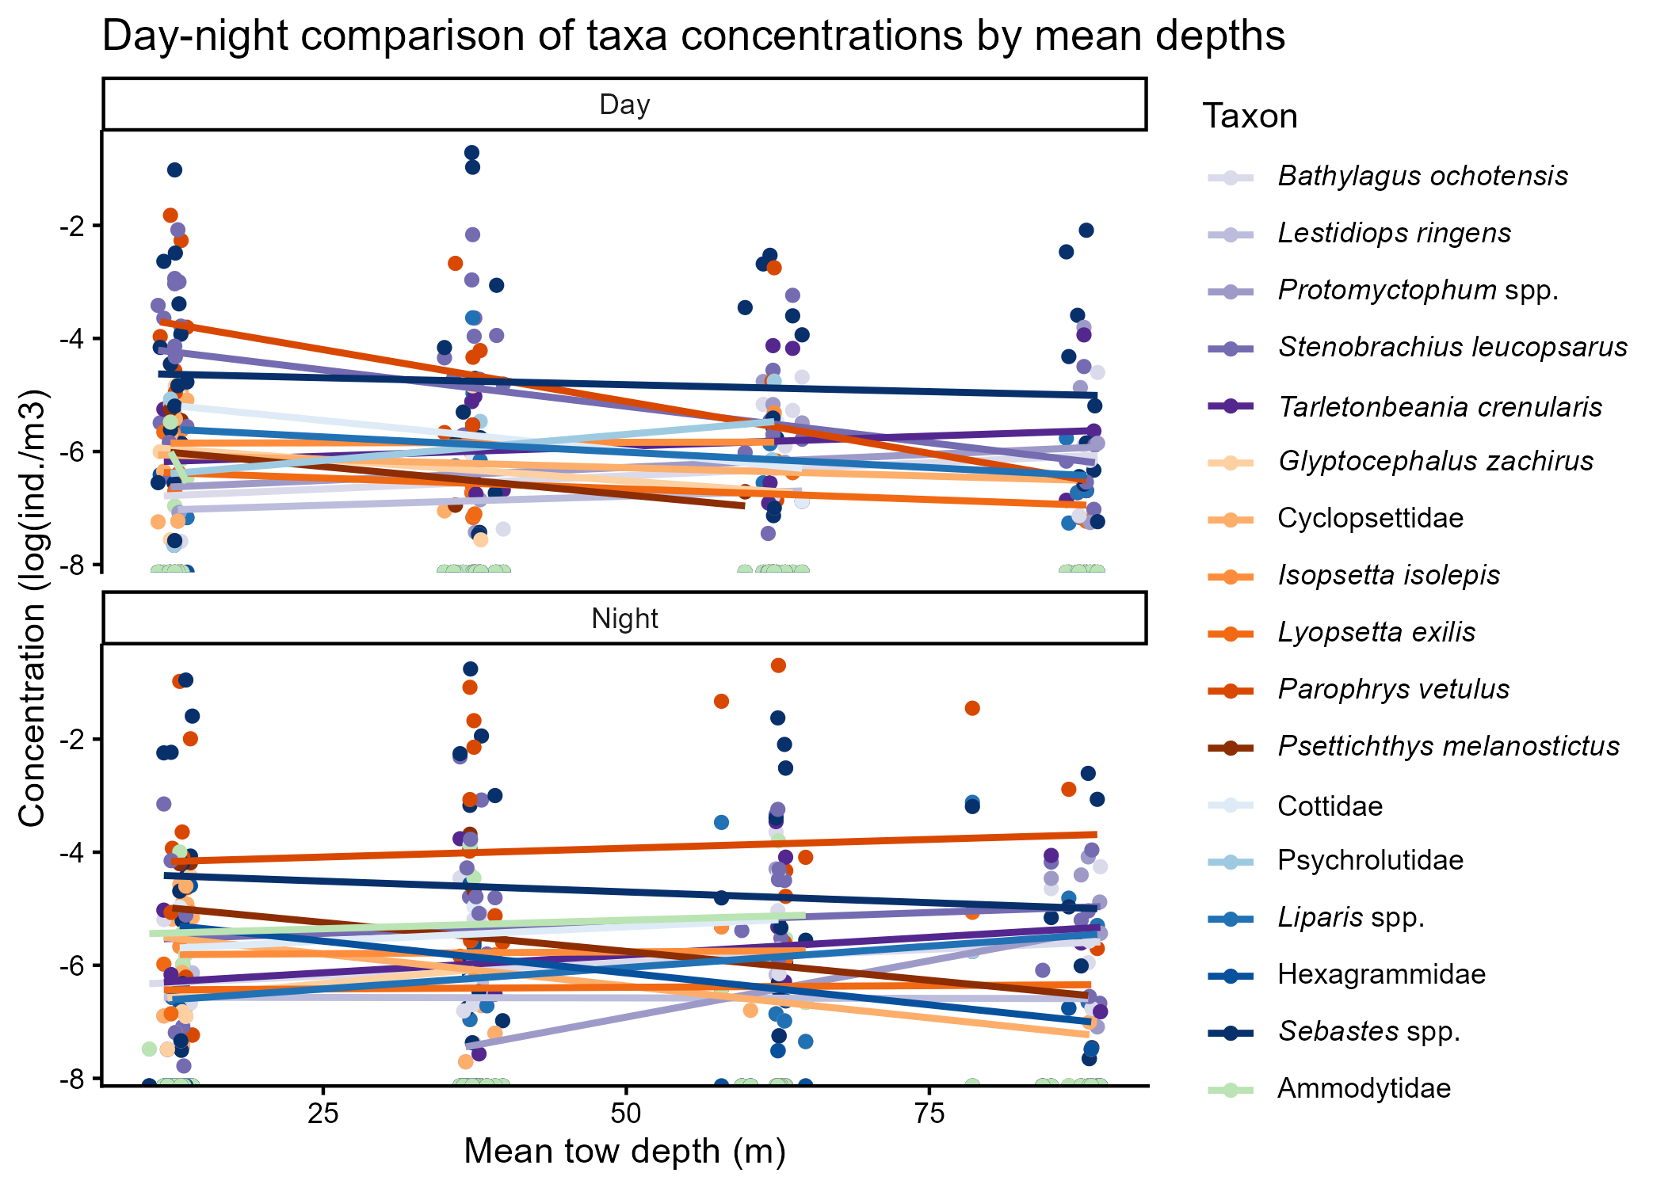
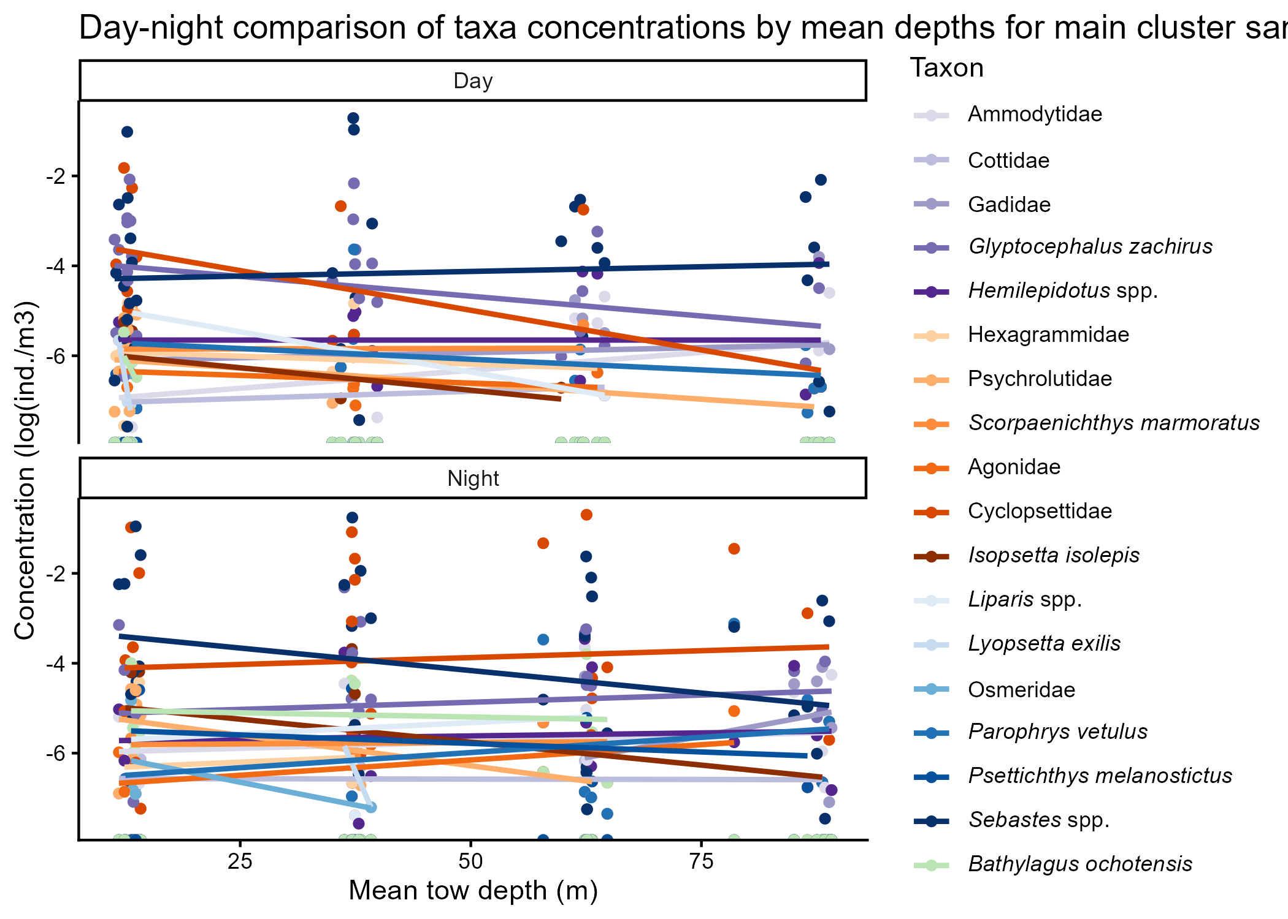
Supplemental Figure 6: …
<- or ->

Slide 31
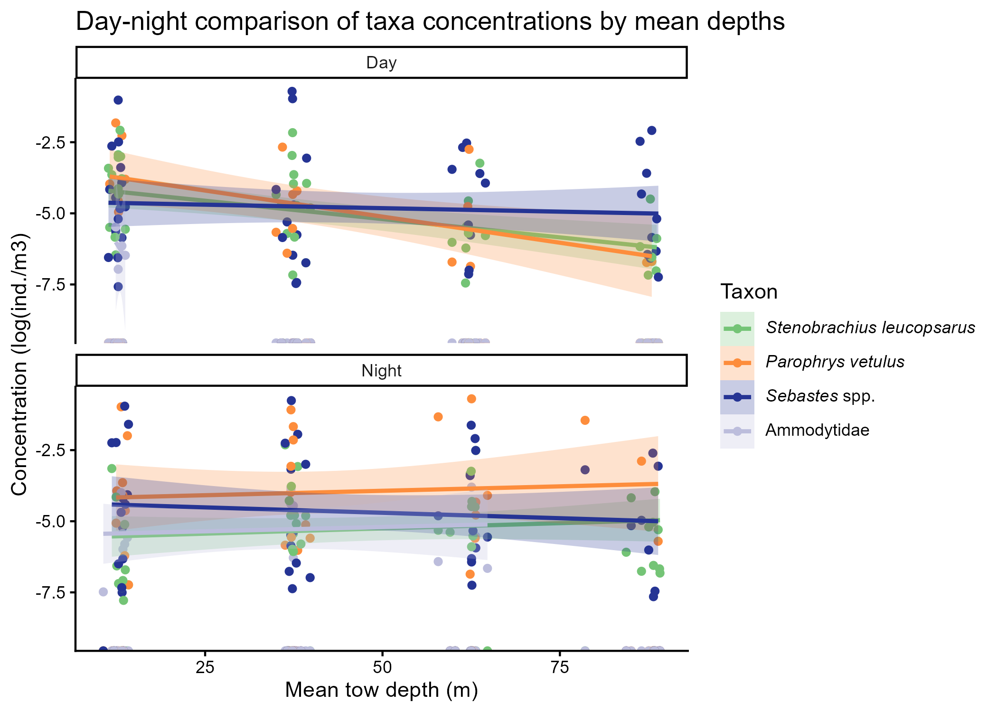
Supplemental Figure 7: …

